Slide 1

ABM for Marketing Diffusion Research
Model version 3-4-5
QianZeHao123/MDS-Research-Project: Agent-based Model (github.com)

Slide 2

My Recent Works in Model Building
In Model version 3: ABM version 0.3 at main
Fix the bugs of creating network: Each agent cannot connect themselves, how influencers add more neighbours
Print the debug information: Print the agents' info like id, influencer or non-influencer, imitator or innovator, neighbourhood list
Save model info to csv: With model data collector to collect Adopted_Count, Influencer_Count, Non_Influencer_Count, Innovator_Count, Imitator_Count
In Model version 4: ABM version 0.4 at main
Pure Python scripts instead of Jupyter Notebook
Separate Agent and Model Class in 2 separated files (Object-oriented programming)
Neighbourhood becomes an attribute of the agent
In Model version 5: ABM version 0.5 at main
Based on model 4, add Batch Running function
Use a seperate file to save parameters settings for ABM model

Slide 3

Now in the Model version 5
We have:
Network generator for Agent Neighbour
Batch running function for multiple parameter combination (I’ve tried the following set)
N = 1000, p=[0.01, 0.02, 0.03], q=0.3
proportion innovators=0.01, proportion influencers = 0.01
In a small world network
Max Steps for Simulation = 100
Each parameter combination for 25 iterations
Export Agent and Model reports (A csv file)

Slide 4
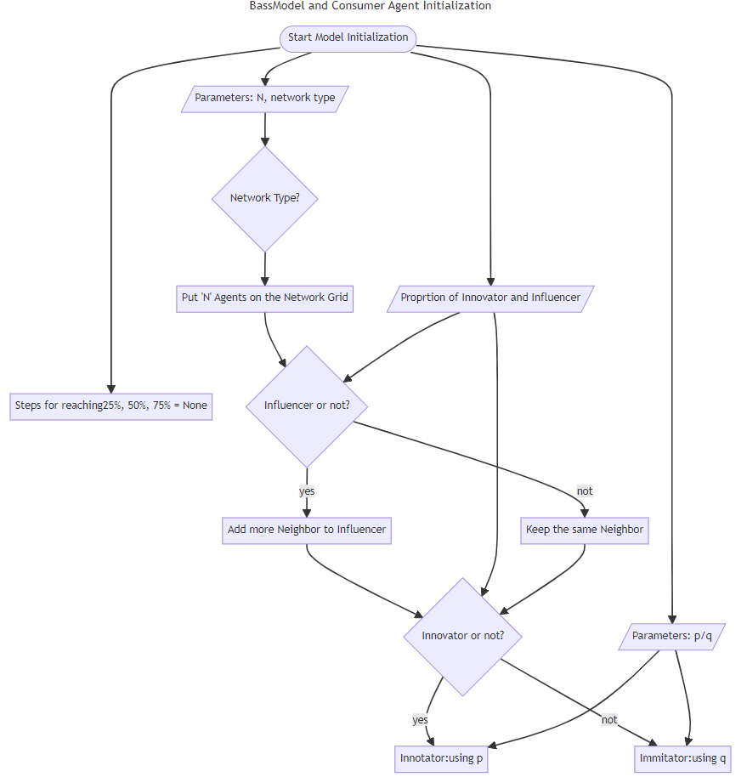
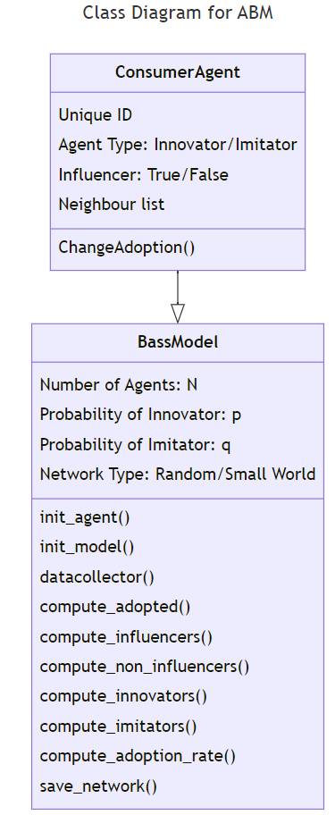
Apply UML in ABM
Class Diagram for Consumer agent and Bass Model:
Attribute for Each Class
Methods for Each Class
Flow Chart for Model Initialization
Access via GitHub: MDS-Research-Project/ABM version 0.5 at main · QianZeHao123/MDS-Research-Project (github.com)

Slide 5

My Recent Works in Model Visualization
Batch Running visualization
Use box plot to demonstrate the trend changes when p applied different value from 0.01 to 0.03
Use line chart to show total acceptors’ accumulation of each iteration
Adopter’s accumulation of different agent type
Innovators vs. Imitators
Influencers vs. Non-influencers
Network Graph for Each Iteration

Slide 6
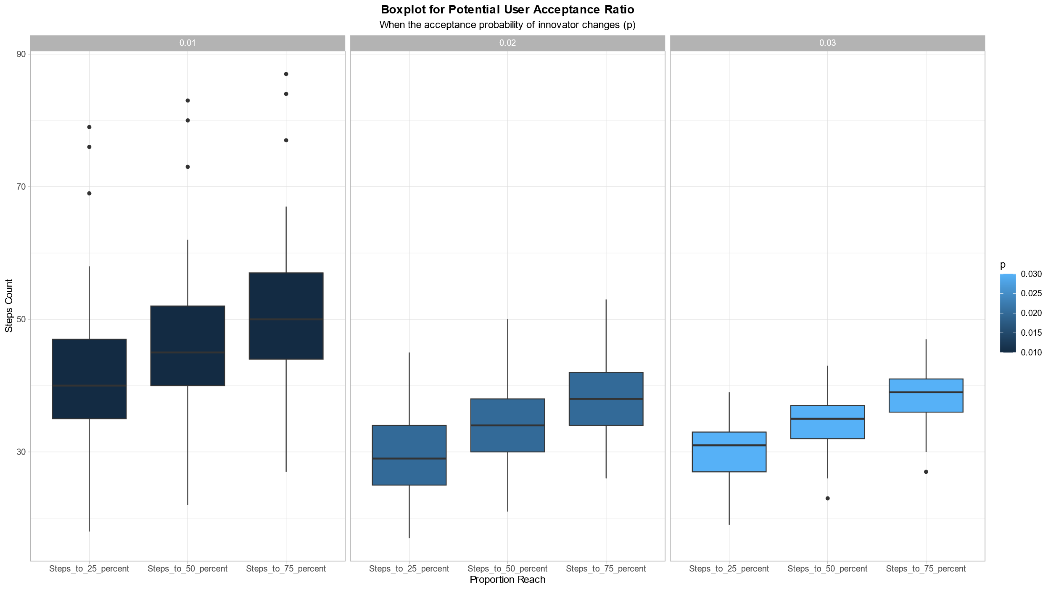

Slide 7
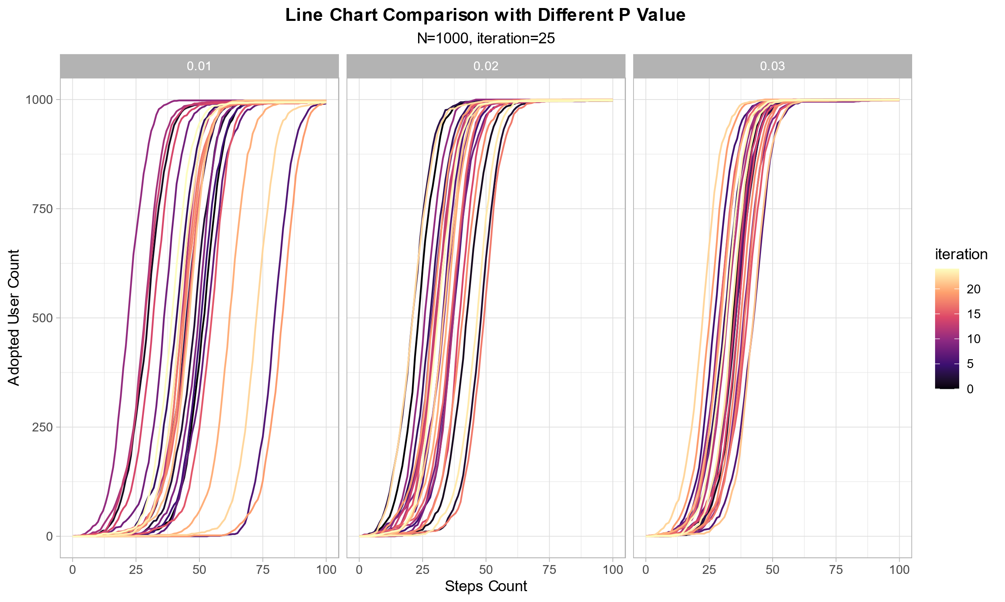

Slide 8
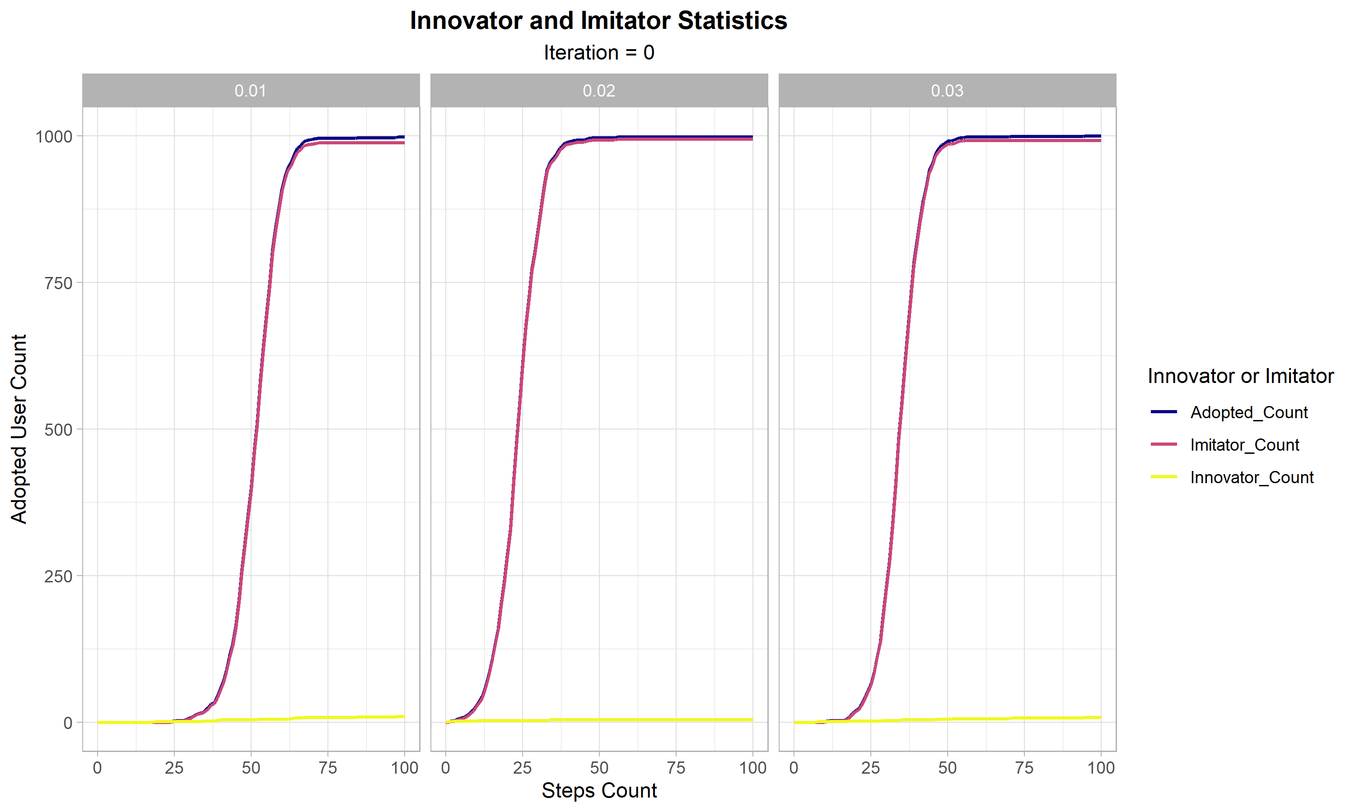

Slide 9
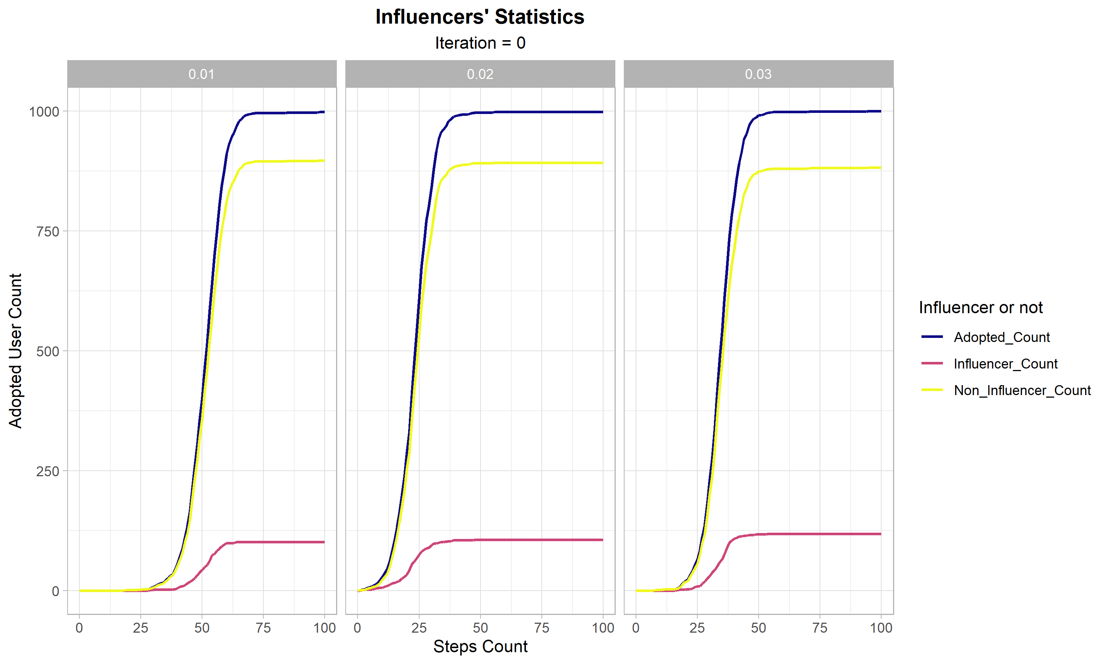

Slide 10
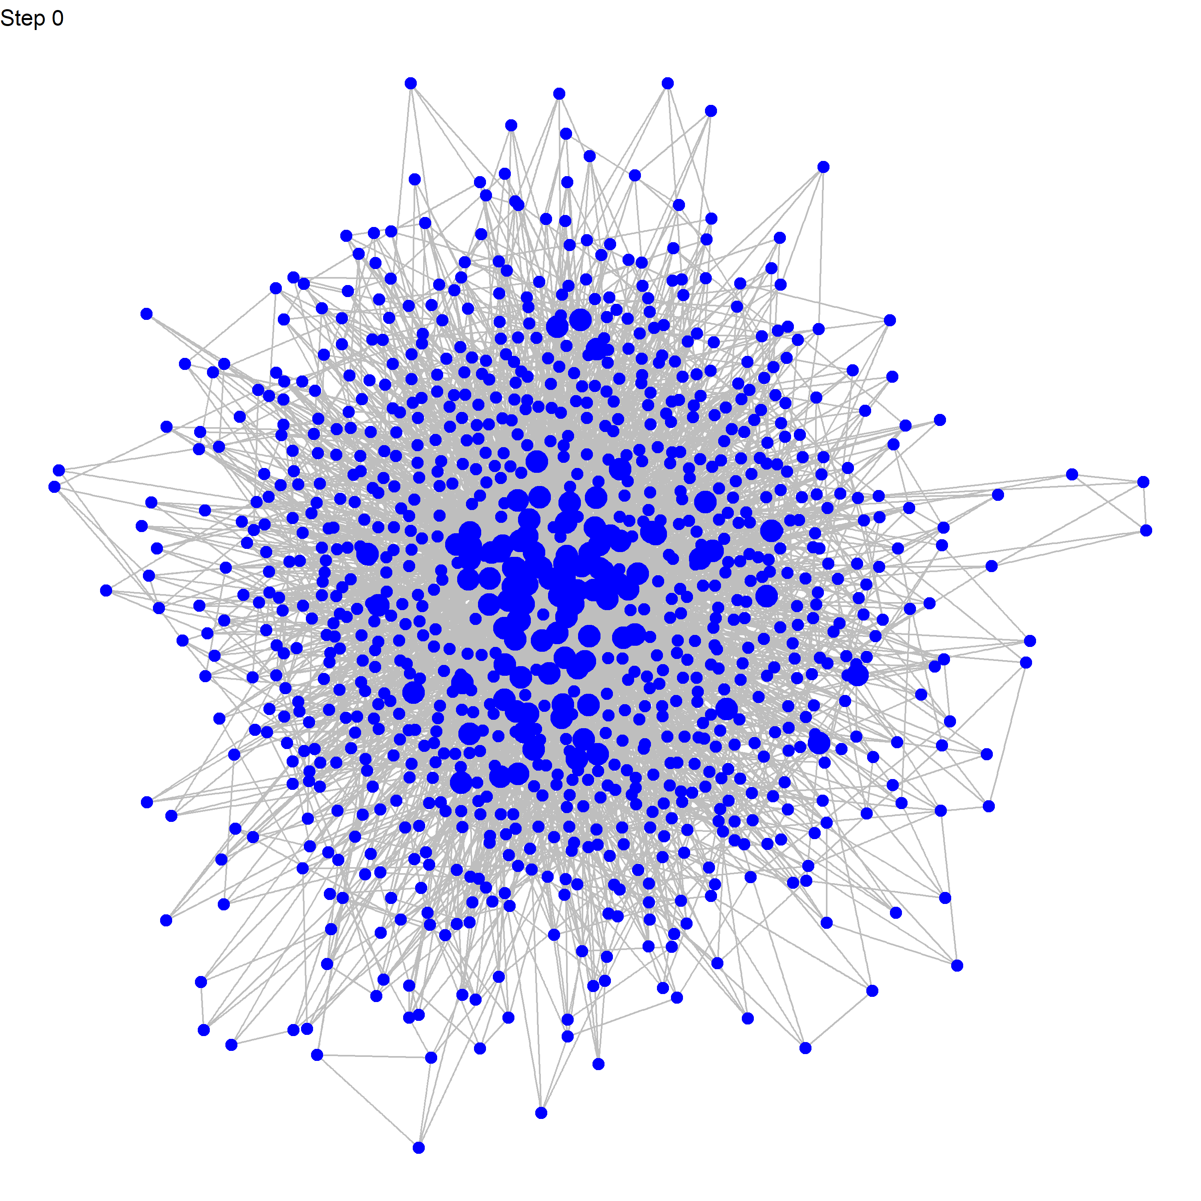

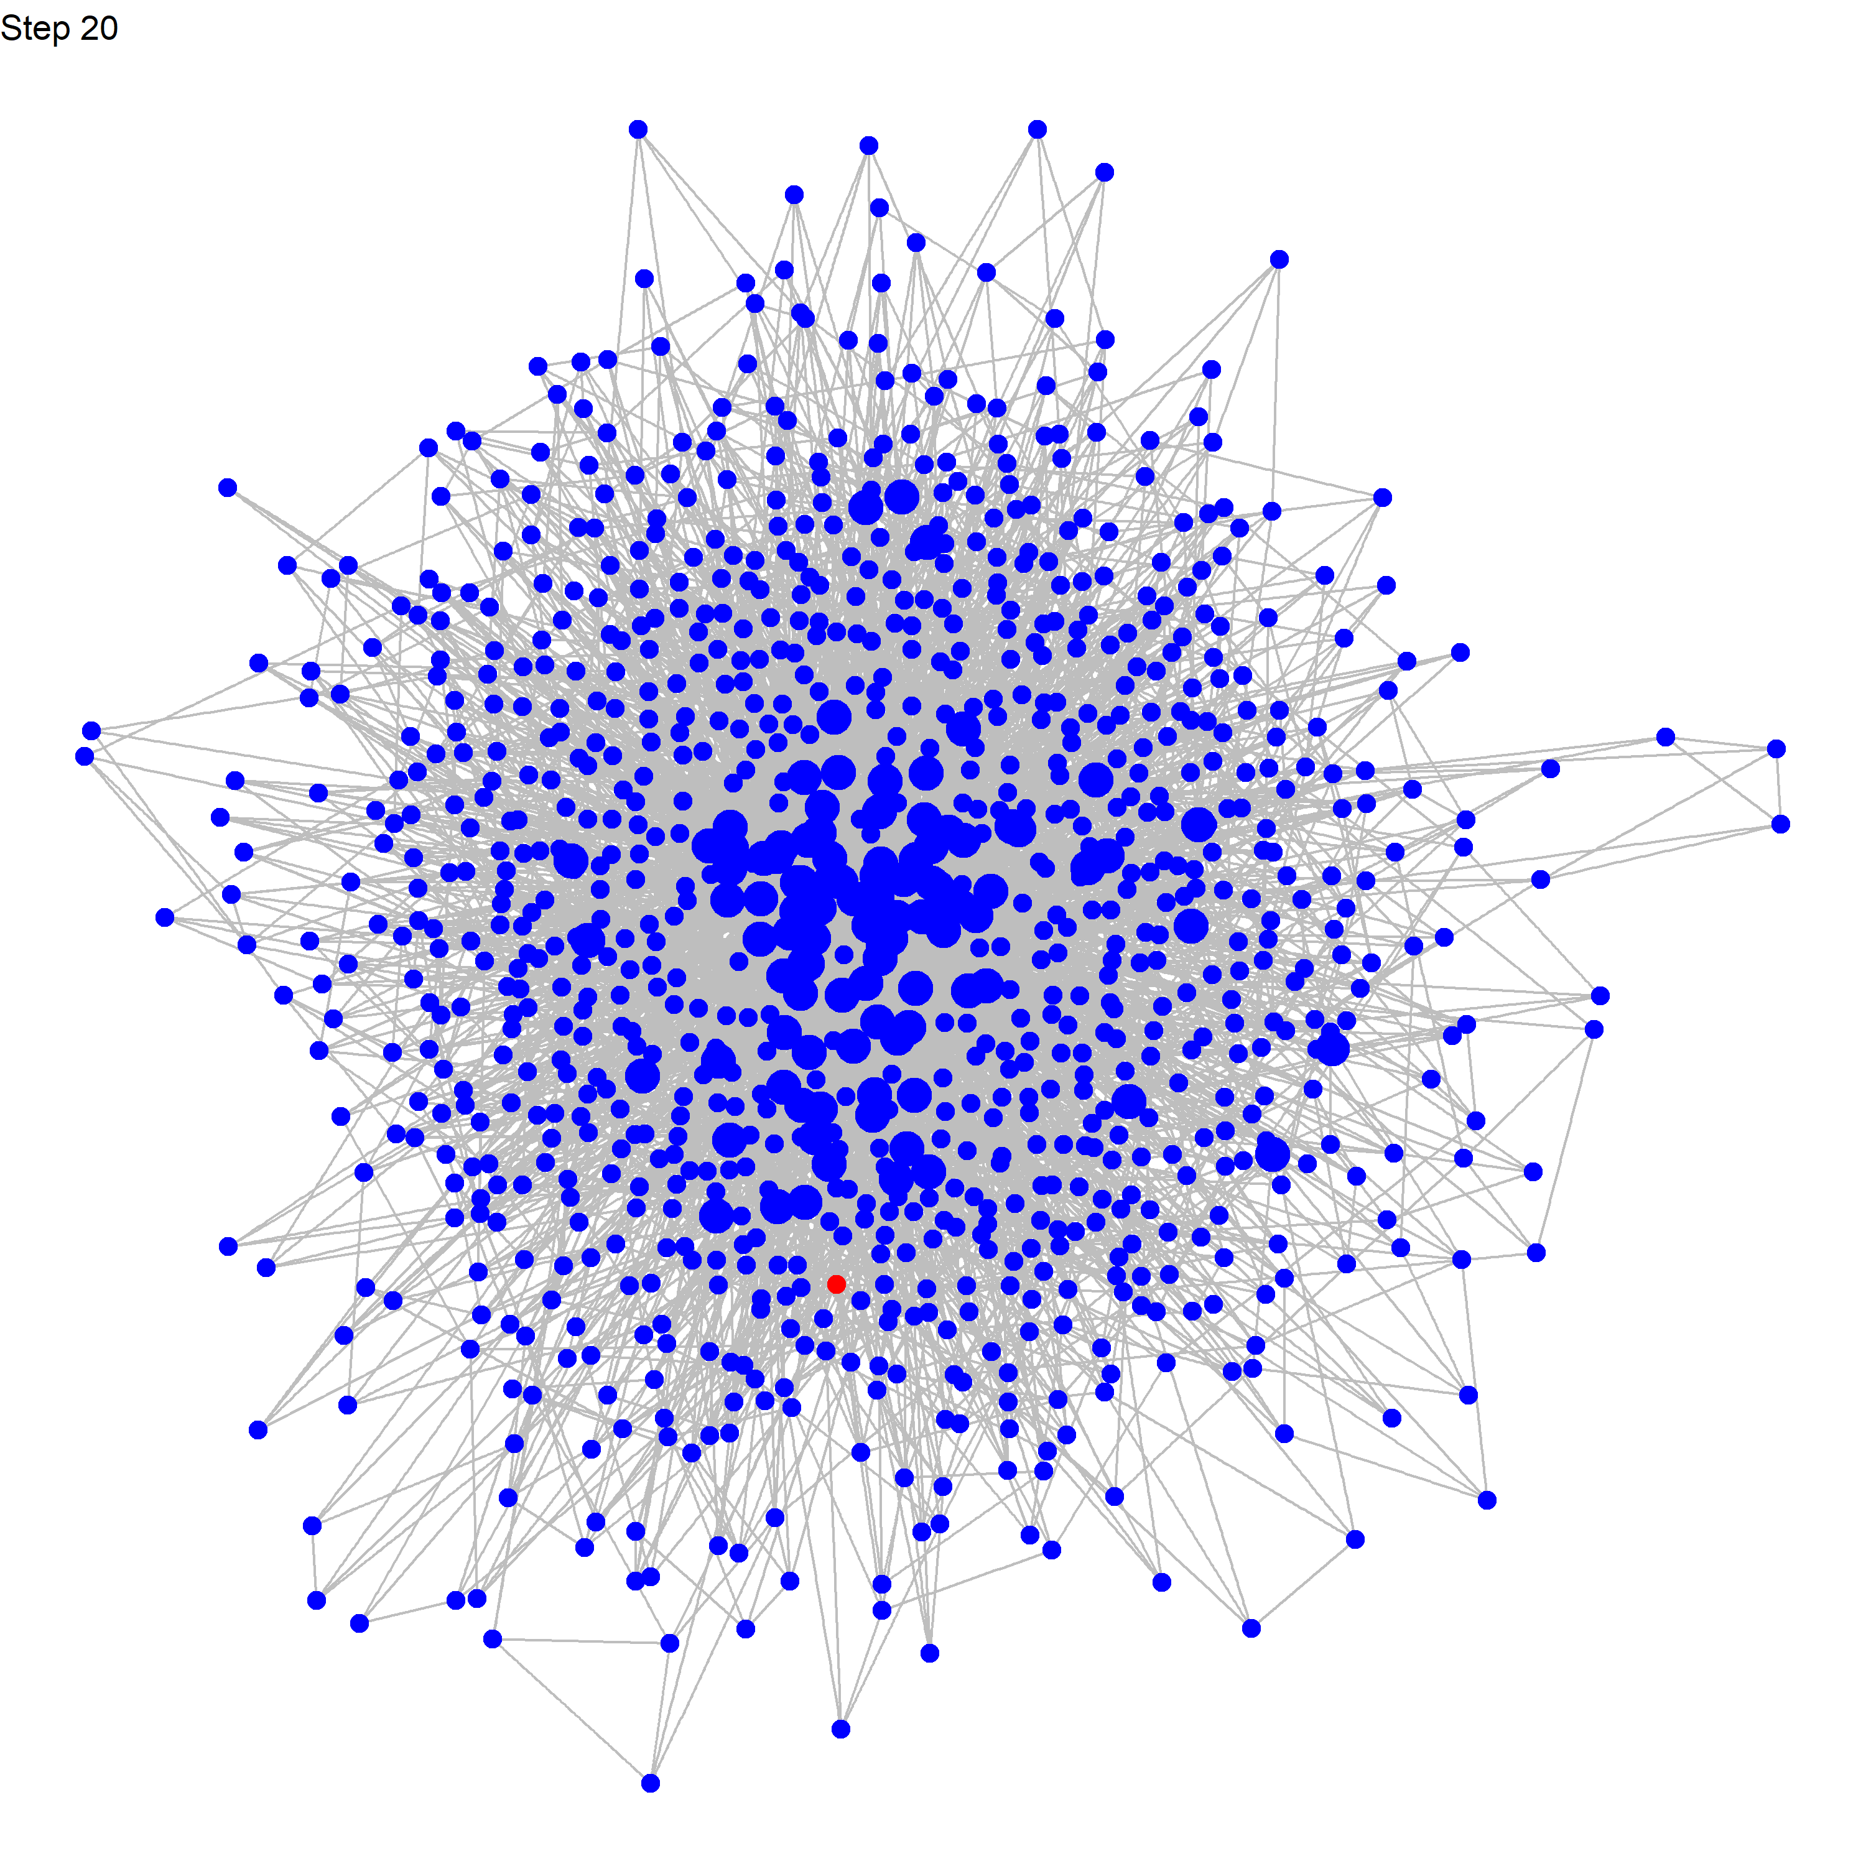

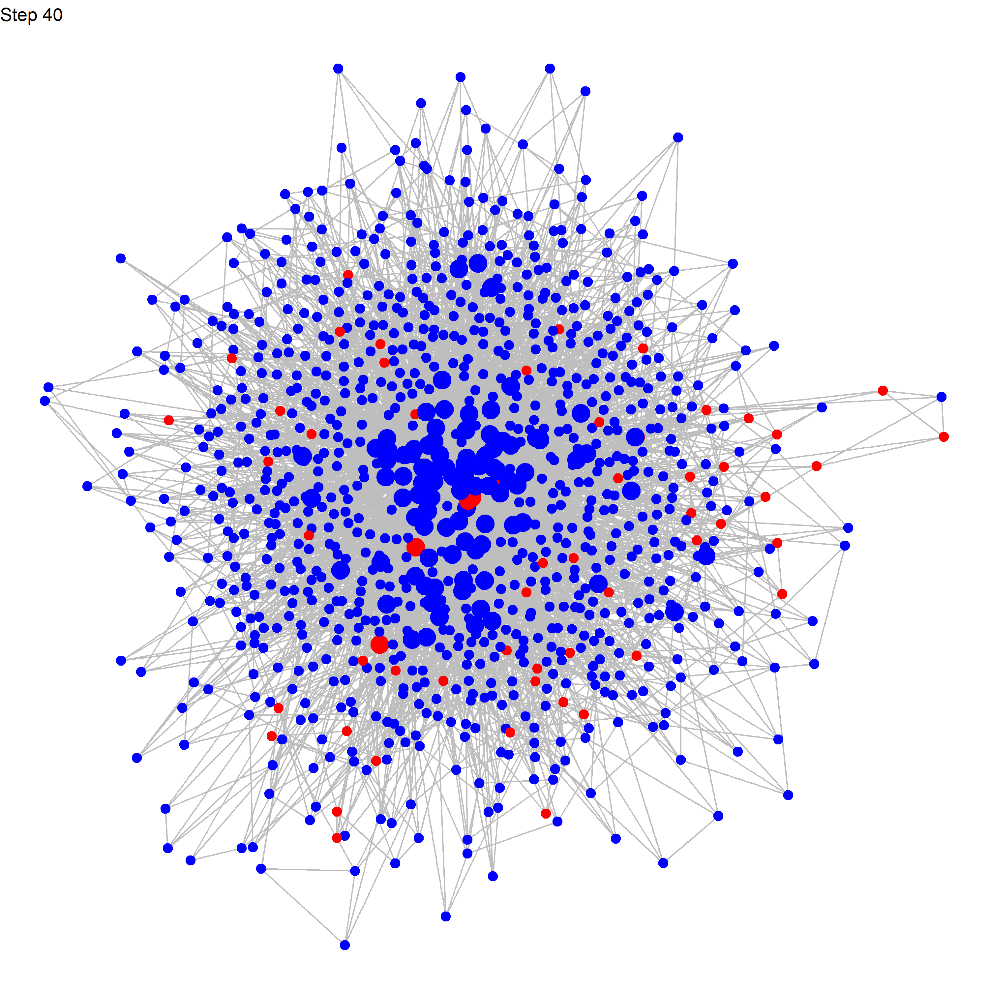
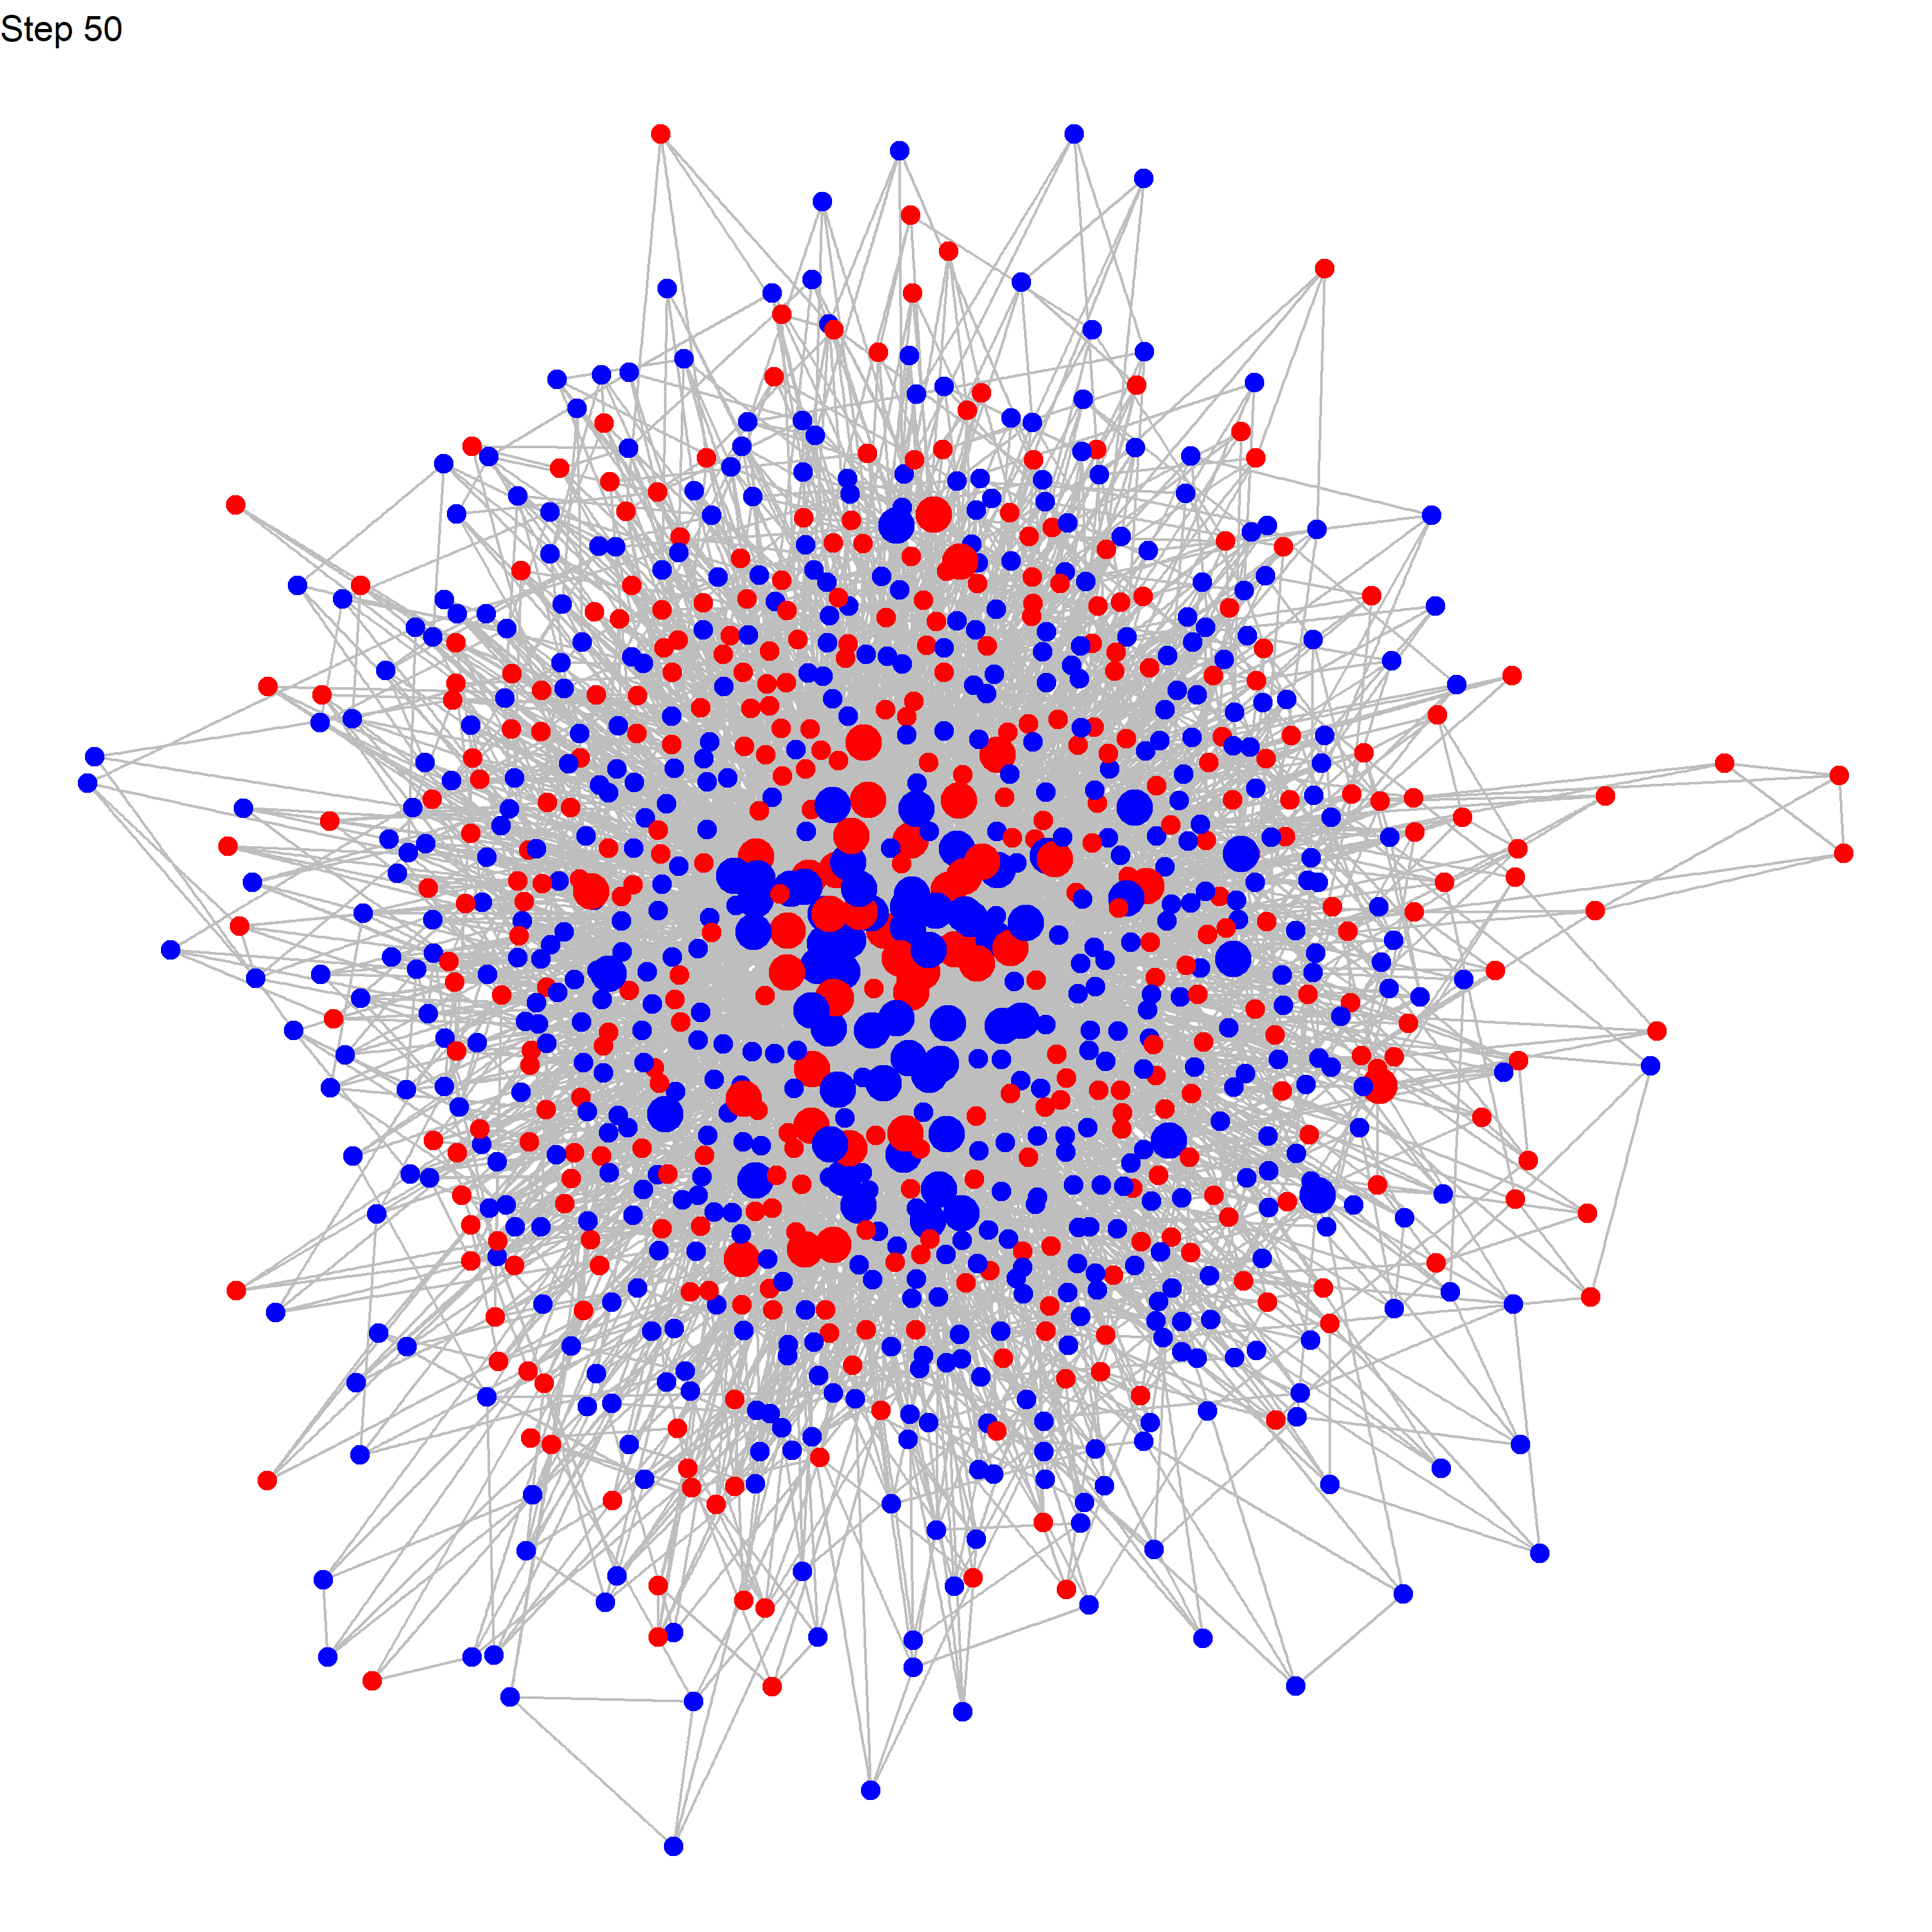
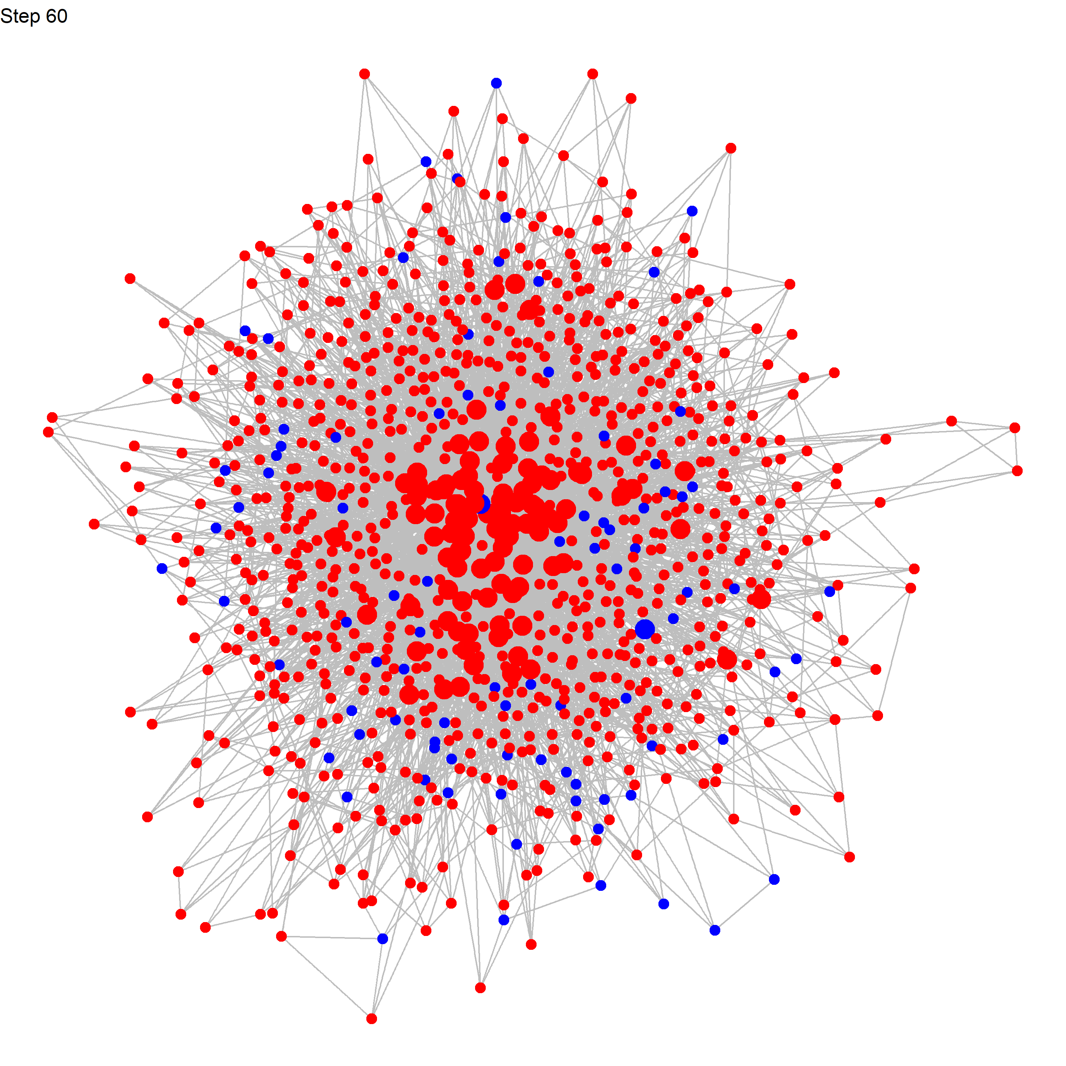
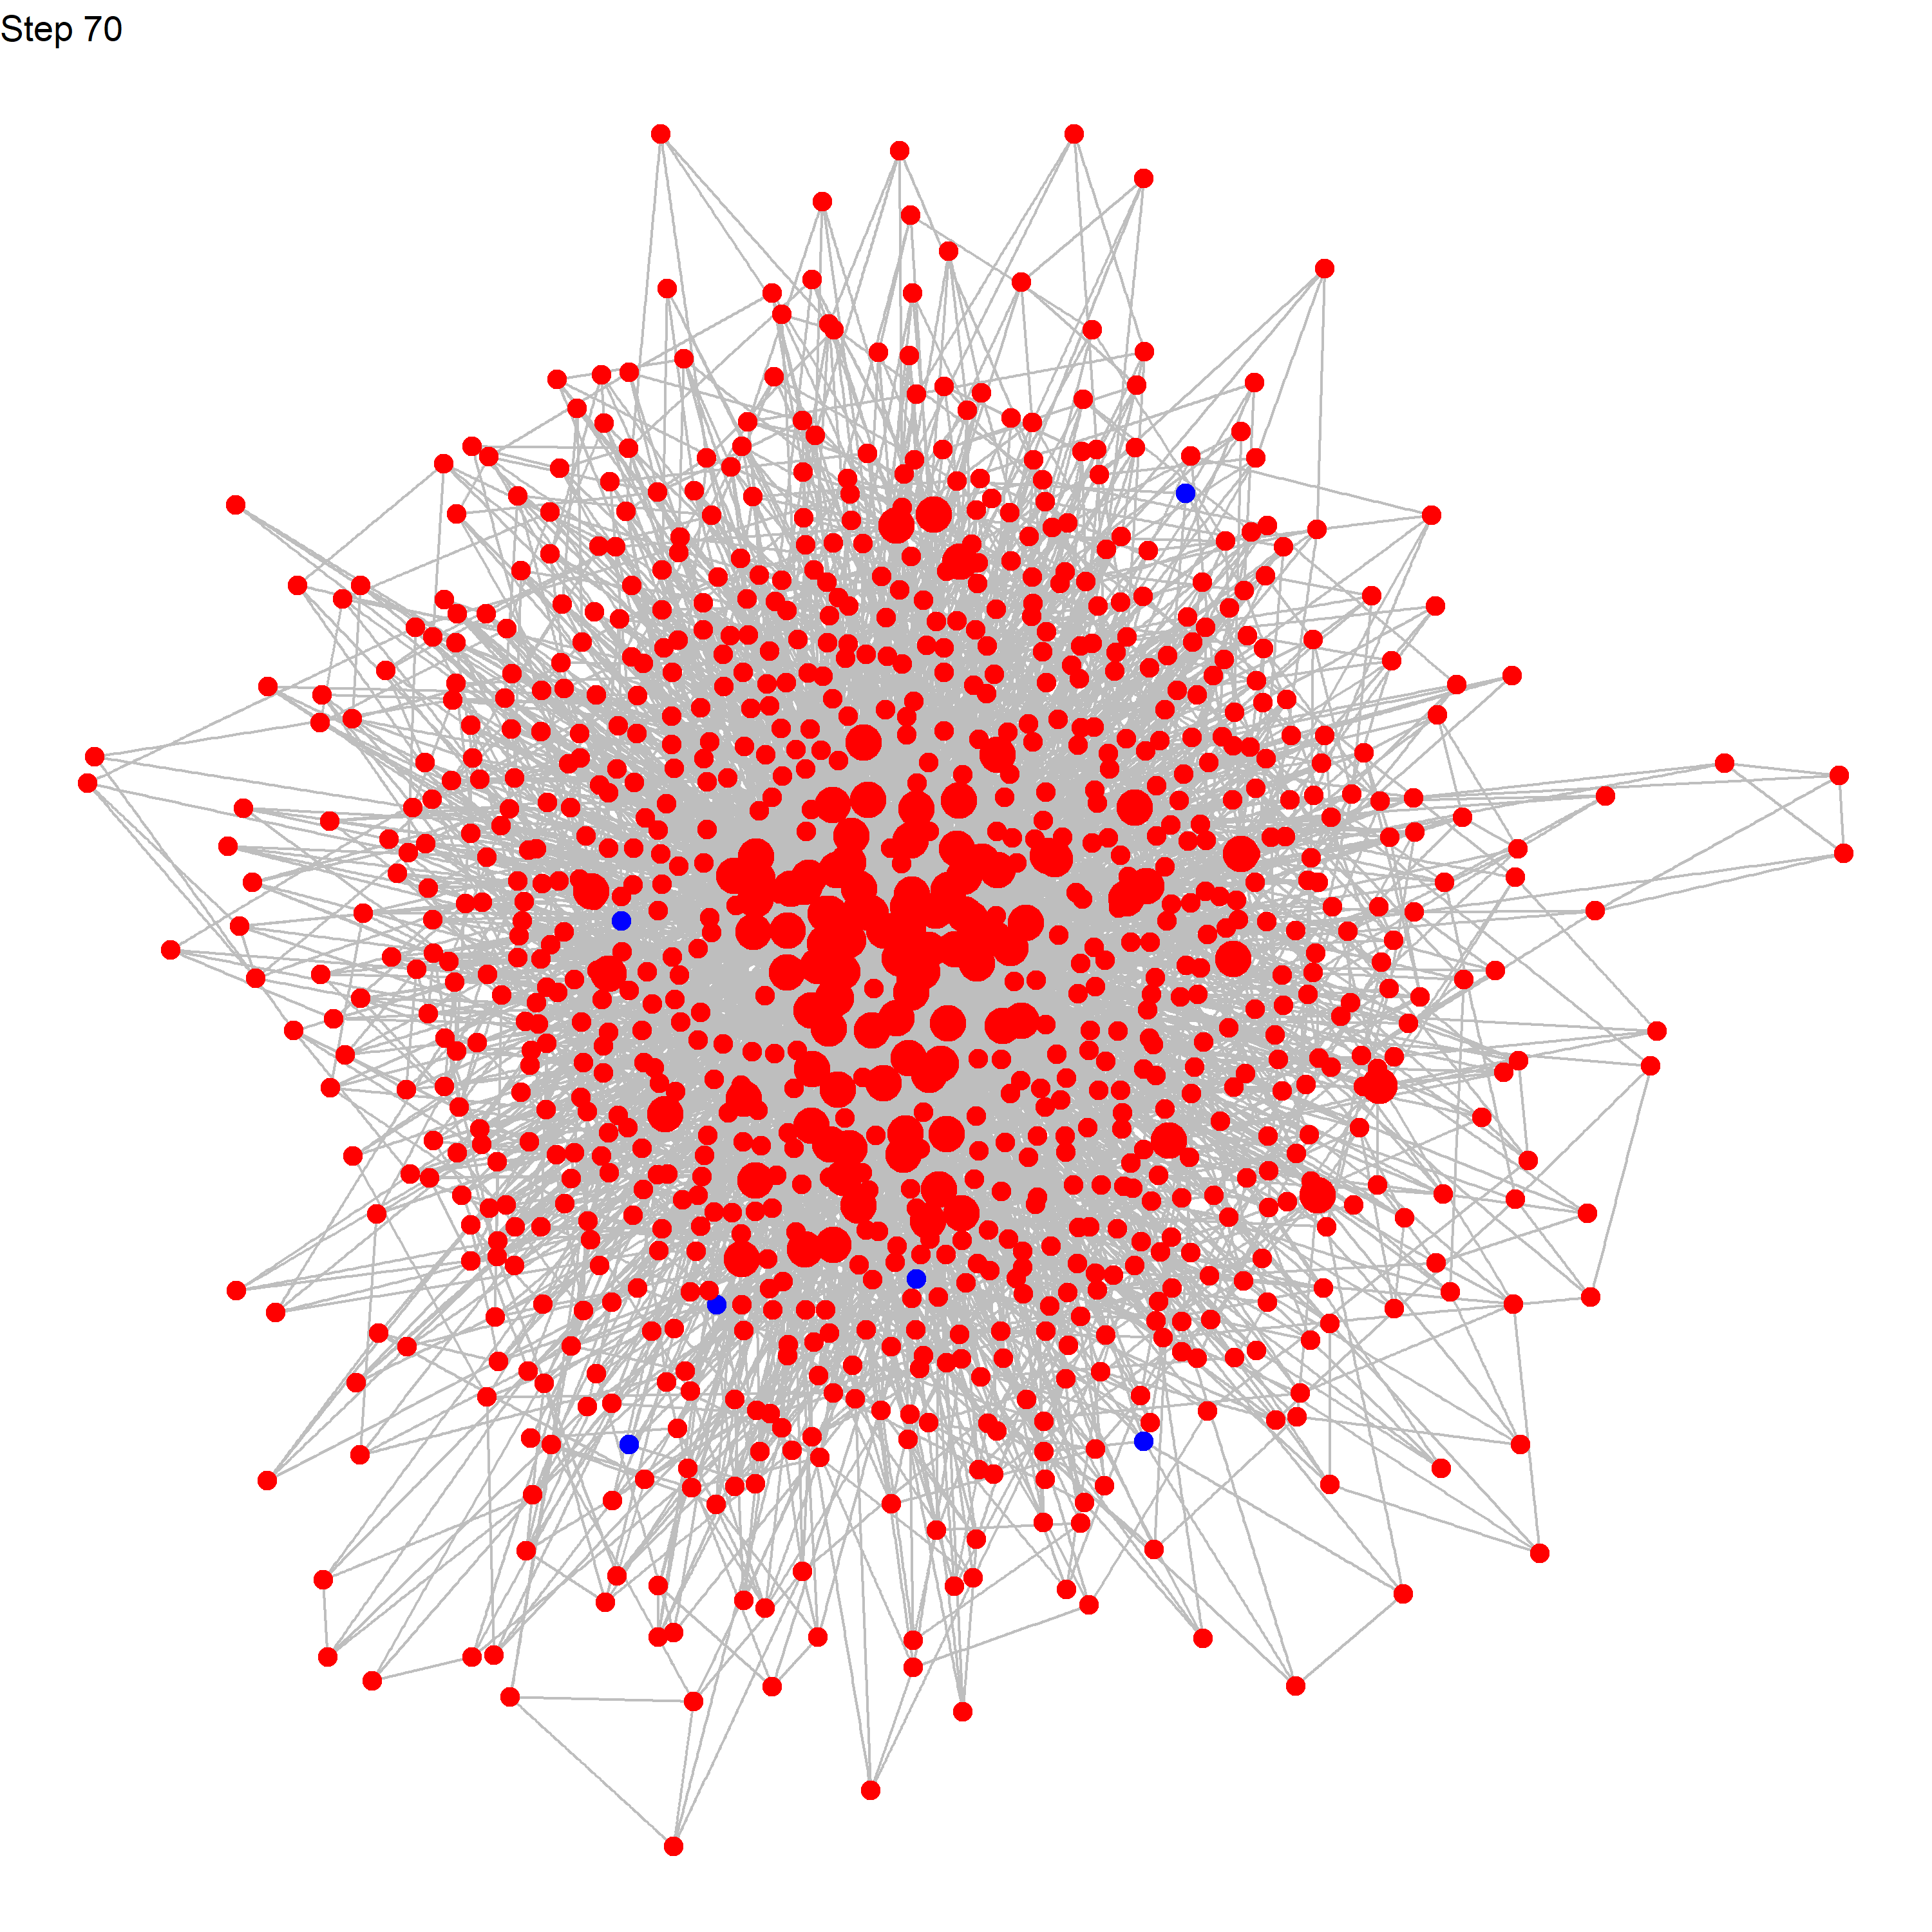
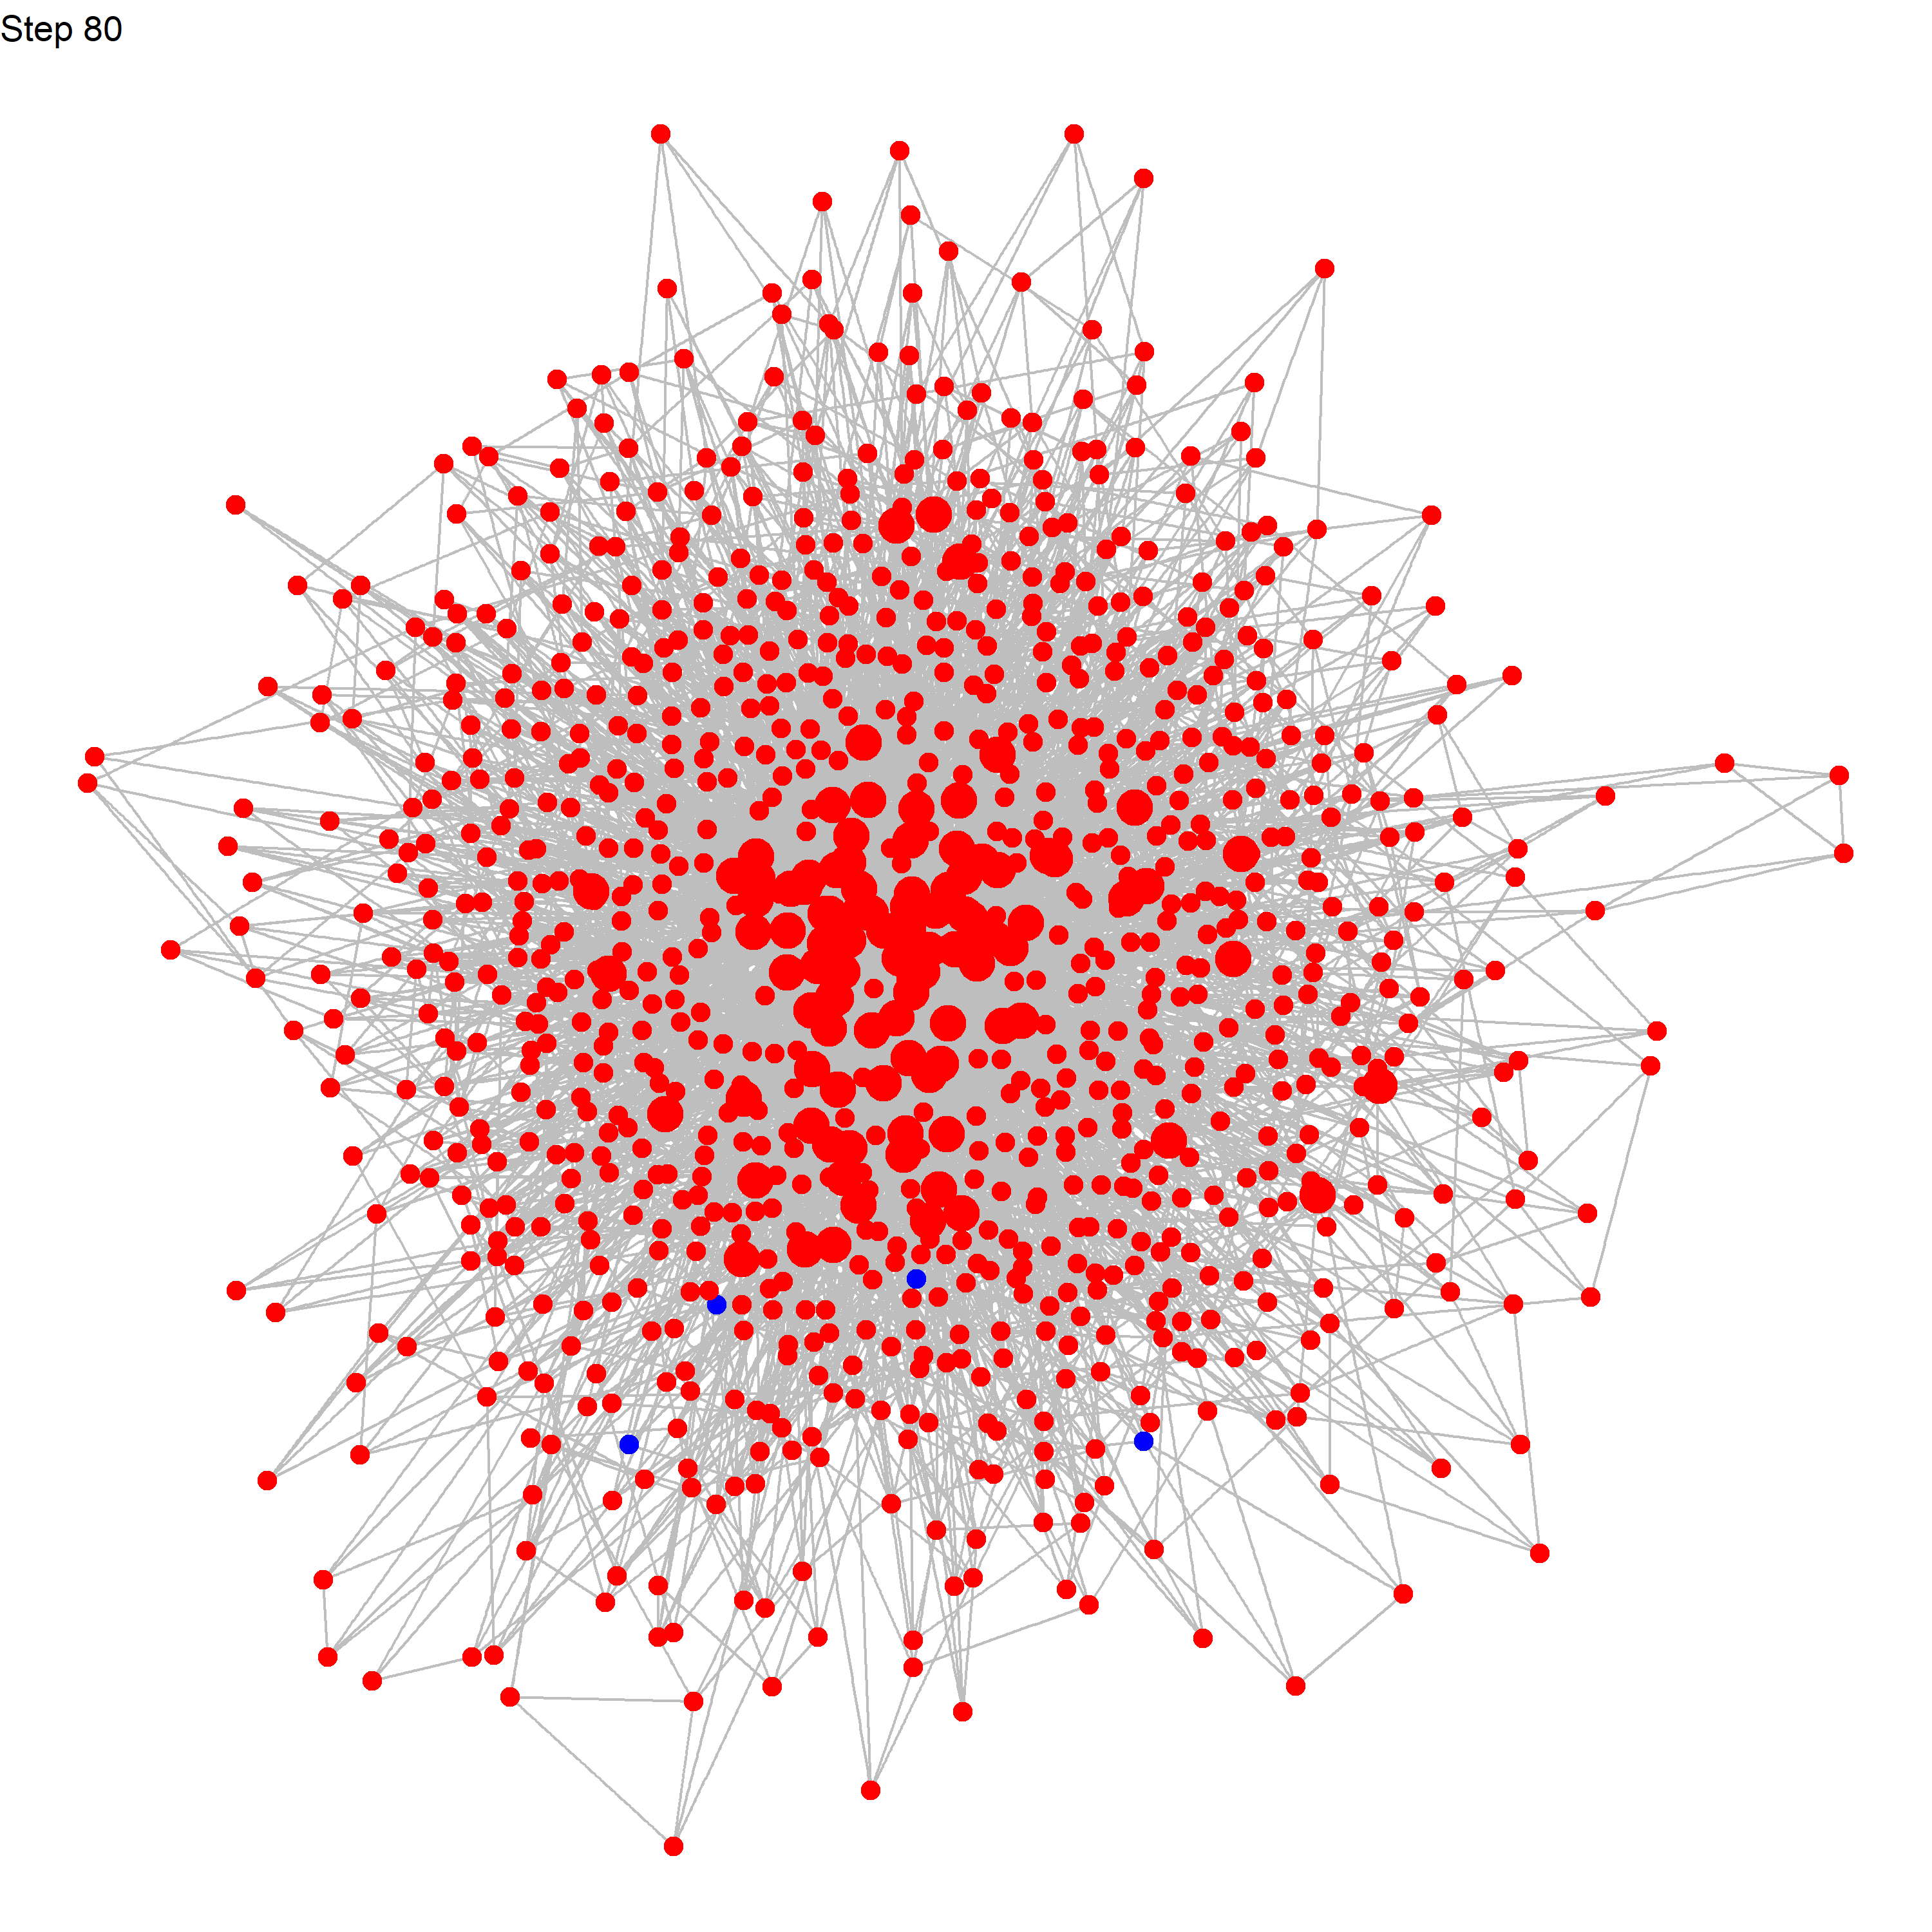

Network Visualization

Slide 11

What I will do for the next weeks
Try different parameters’ combinations (not just change p’s value):
p = [0.01, 0.02, 0.03], q = [0.3, 0.4, 0.5], N = [100, 500, 1000], …
But my model would generate an extremely huge dataset = max_steps * iterations * p * q * N….
Make the visualization prettier
Start writing the paper content

Slide 12
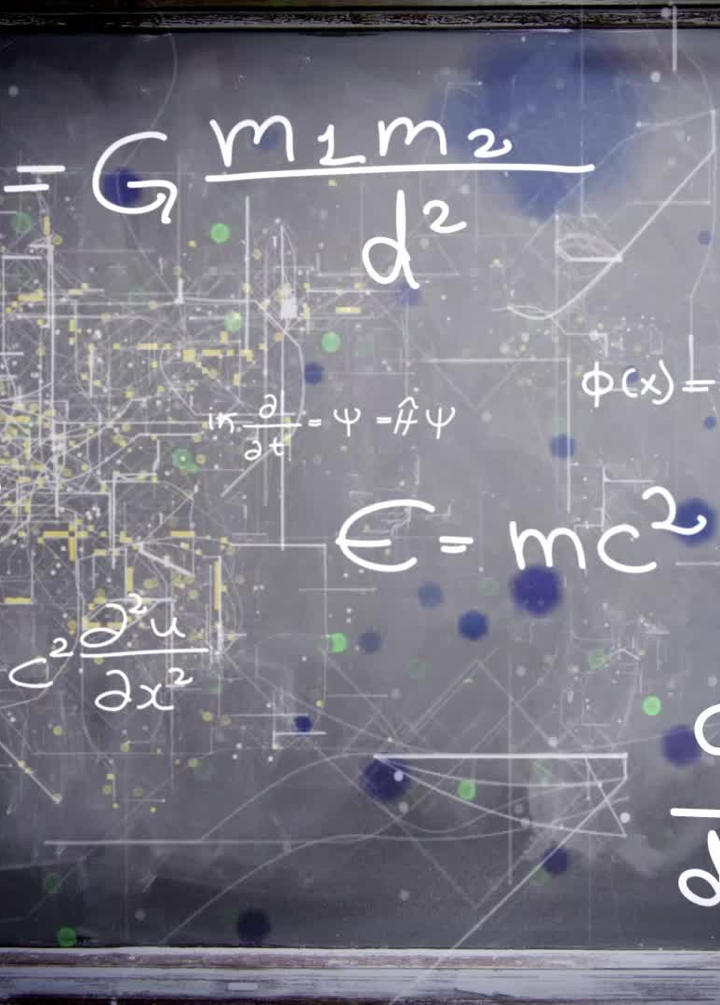
Questions for today’s meeting
Advices about my visualization and model building jobs
How to show different parameter combinations result?
For the model version 5, if I need to update my model to control 4 different people’s proportion like inno_infl = a, inno_non_infl = b, imit_inf = c, imit_non_inf = d, a+b+c+d=1 to find out if one population’s value = 0, what will happen? If so, I need to change my model, instead of prop of innovators and influencers, set a, b, c, d.

